Slide 1
Nu-2000 ver2.0 Update
Creativity & Confidence
연구소
2023.05.25
www.atikorea.com

Slide 2
Contents
Overview : Nu-2000 ver2.0
01
Update Summary
02
Details
03

Slide 3
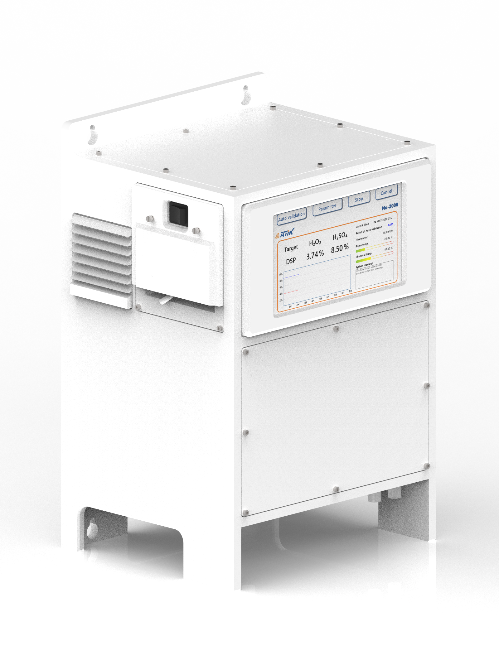
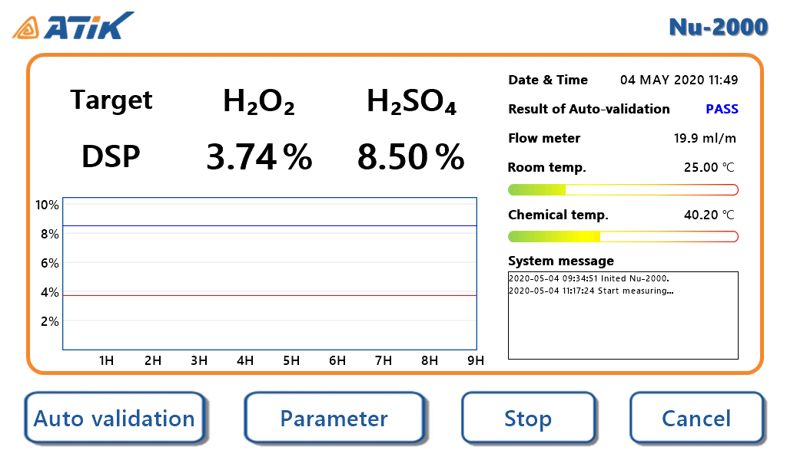
Overview : Nu-2000 ver2.0
Design
Increasing the display size from 7’’ to 10.1’’
Update to a new version of the UI
Function
New measure targets are available (SC-1, 2MA1)
Added: Auto-calibration for light sources (Advanced mode)
Added: Update LED&LD status function after replacement
Enhanced: Life-time of the LED (Applying the QCW mode )
Enhanced: Auto-validation
Enhanced: Temperature management
Size(mm) : 369 x 309 x 540 (WxDxH)
Etc
Users can choose between Standard and Advanced modes
Standard Mode
Advanced Mode
※ Advanced mode provides the auto-calibration for light sources and sensors.
Nu-2000 Ver2.0 UI

Slide 4
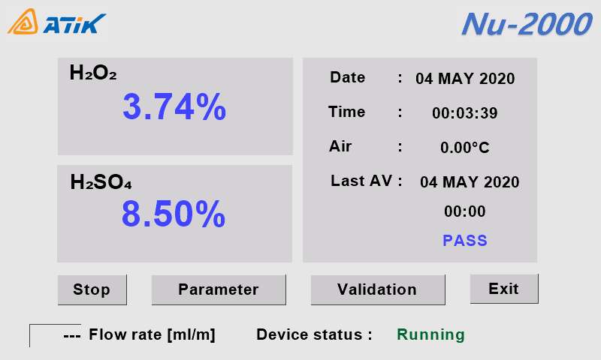
Update summary
Contrast Table
 |  | Ver1.0 | Ver2.0 Standard | Ver2.0 Advanced
Design | Size | 369 x 309 x 540
 | Display | 7’’ Resistive touch LCD | 10.1’’ Resistive touch LCD
 | UI
Function | Target | DSP | DSP, 2MA1, SC-1
Function | LED Life-time | UV : 8,000H, IR : 80,000H | UV : 40,000~50,000H, IR : 400,000~500,000H
Function | Auto-calibration (for light sources) | X | X | O
 | Update LED (for Replaced LED) | X | O | O
 | Auto-validation | O | O* | O*
 | Temperature Management | O | O* | O*

Slide 5
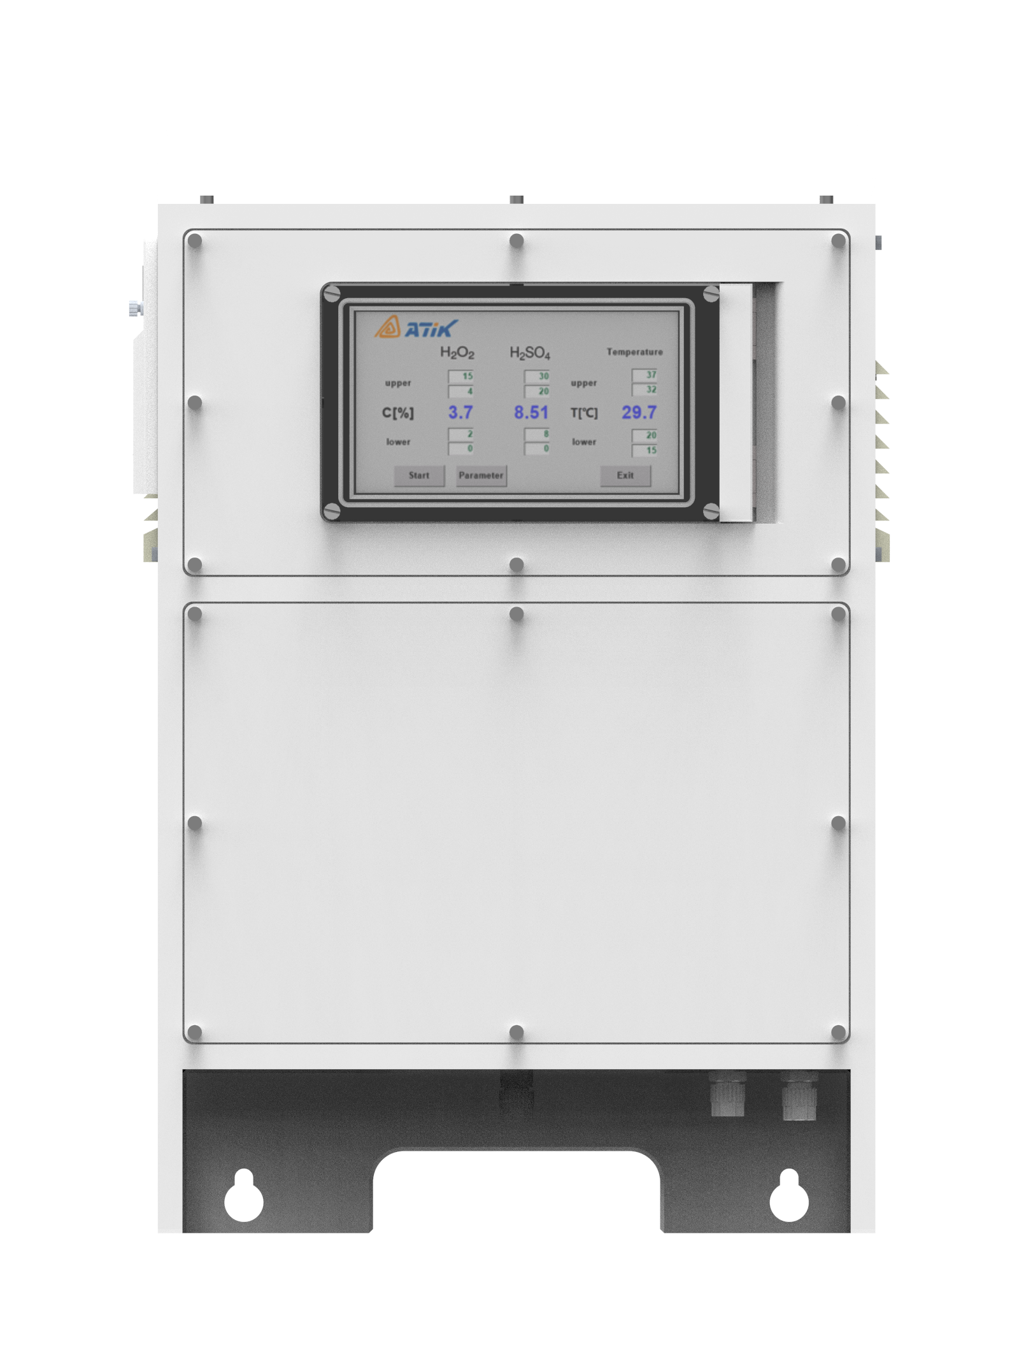
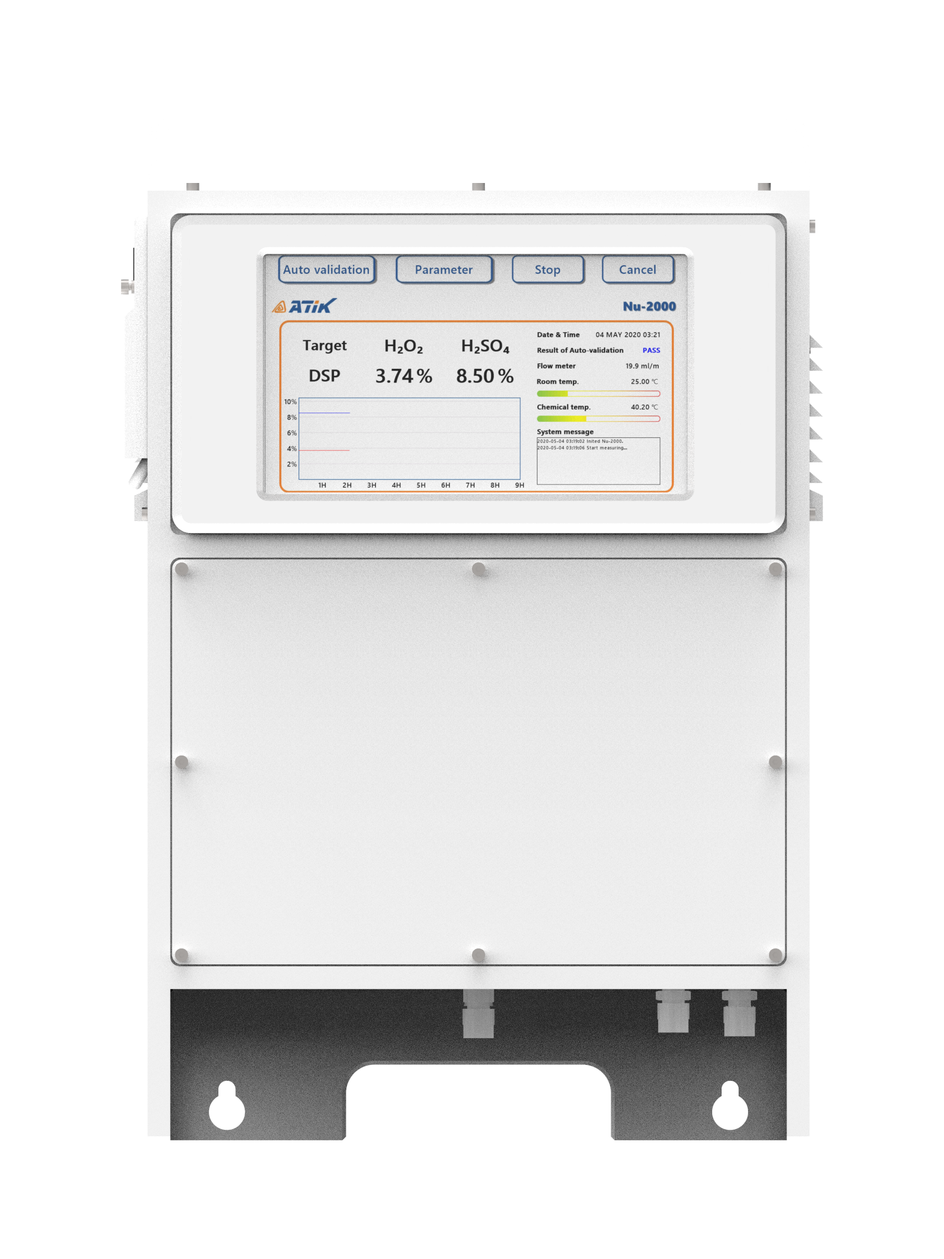


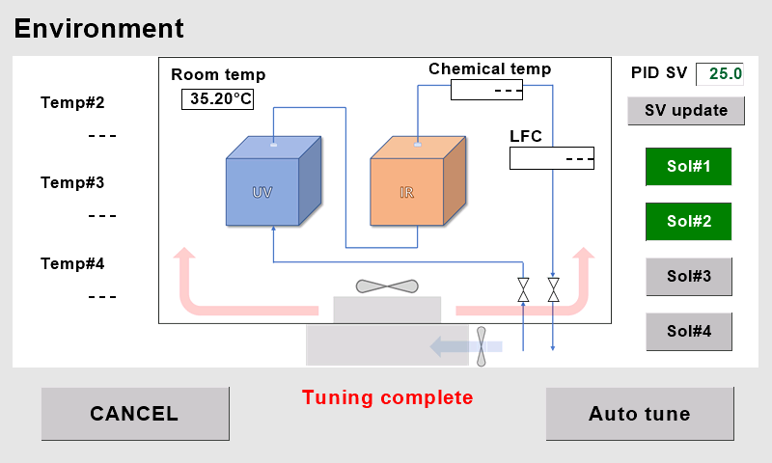
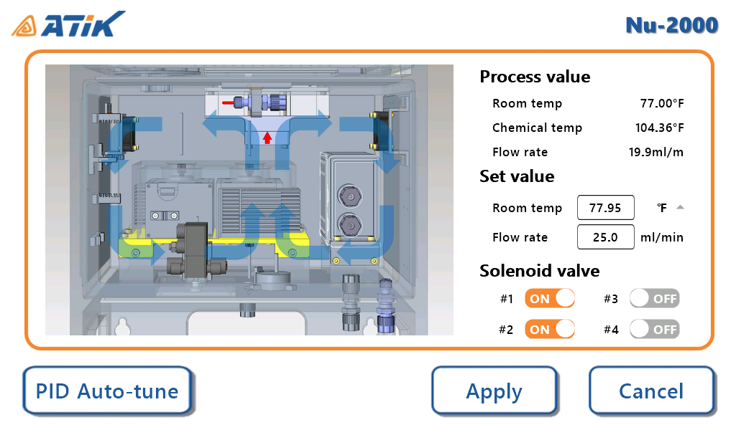
Details - design
Increasing the display size from 7’’ to 10.1’’
Nu-2000 Ver1.0
Nu-2000 Ver2.0
Increasing the display size from 7’’ to 10.1’’
Update to a new version of the UI

Slide 6
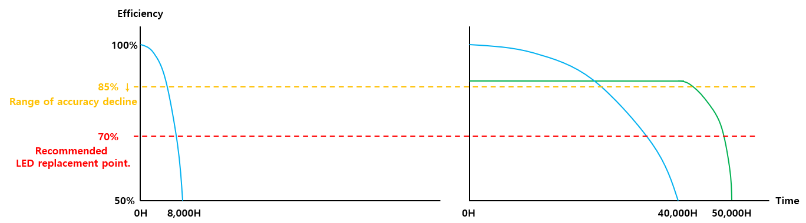
Details - function
QCW mode & Auto-calibration for light sources (only advanced mode)
Nu-2000 Ver1.0
UV LED life-time
Nu-2000 Ver2.0
UV LED life-time
Auto-calibraion not applied
Auto-calibraion applied
 | Nu-2000 Ver1.0 | Nu-2000 Ver2.0 (QCW mode)
 |  | Standard | Advanced
Life-time | 8,000H | 40,000H | 50,000H
Recommended replacement LED | 7,000H | 27,000H | 47,000H
Range of high accuracy | 4,500H | 18,000H | 45,000H
※ The lifetime can vary depending on the user's equipment usage methods.

Slide 7
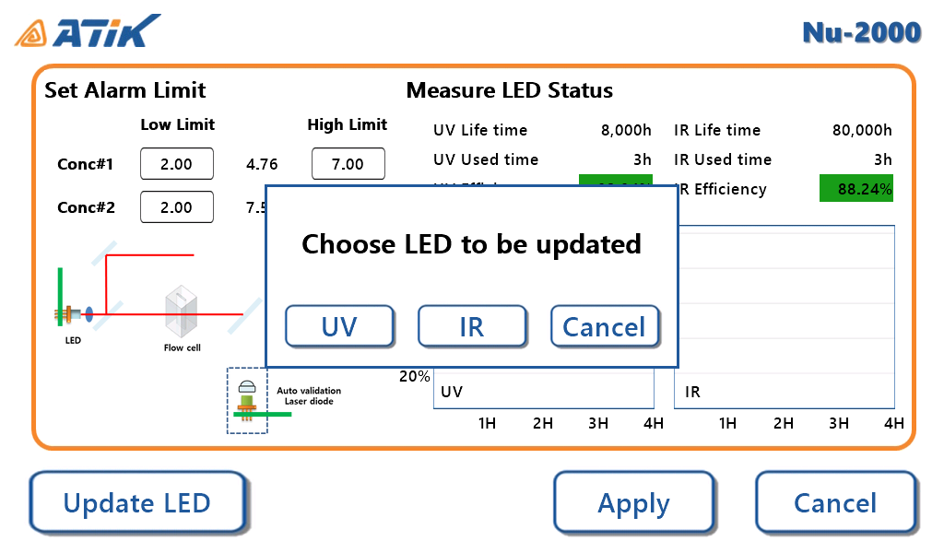
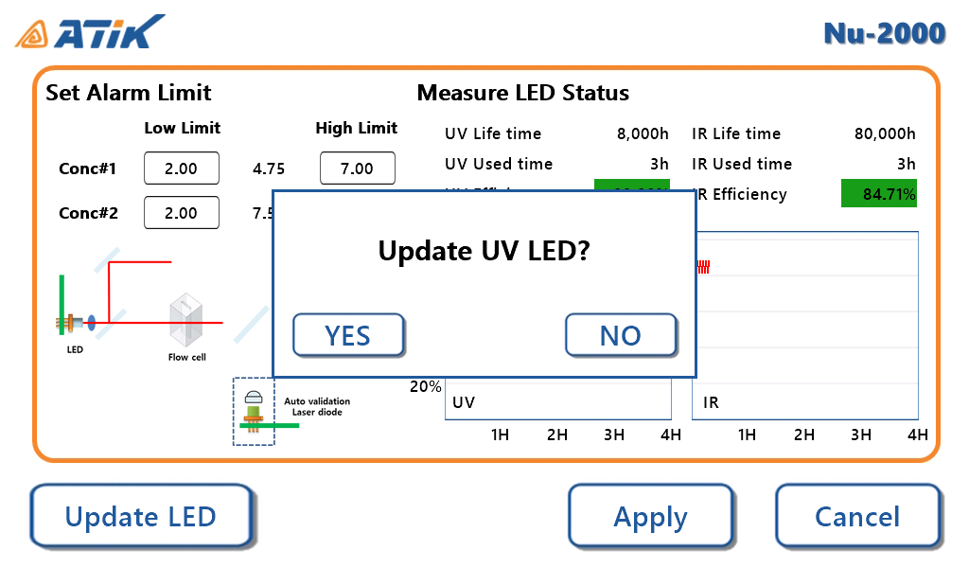
Details - function
Update LED status function after LED replacement
Functions activated after LED replacement
Updating the initial light output value of the LED
The efficiency of the LED is determined based on the initial light output value
※ When the function is executed, the efficiency of the LED will be reset to 100%
※ Never use this function if the LED has not been replaced.

Slide 8
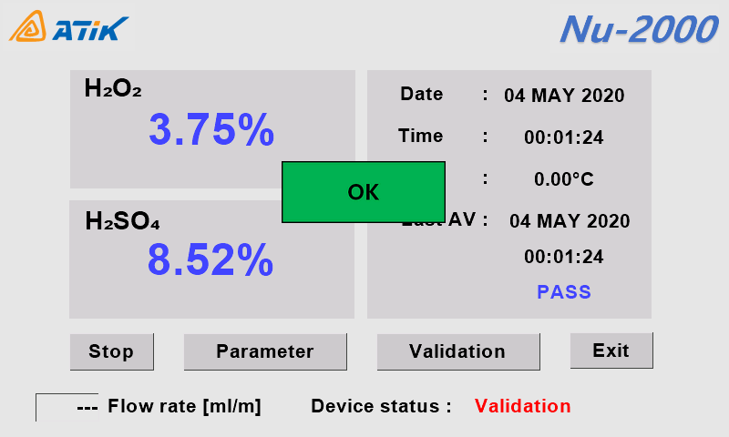
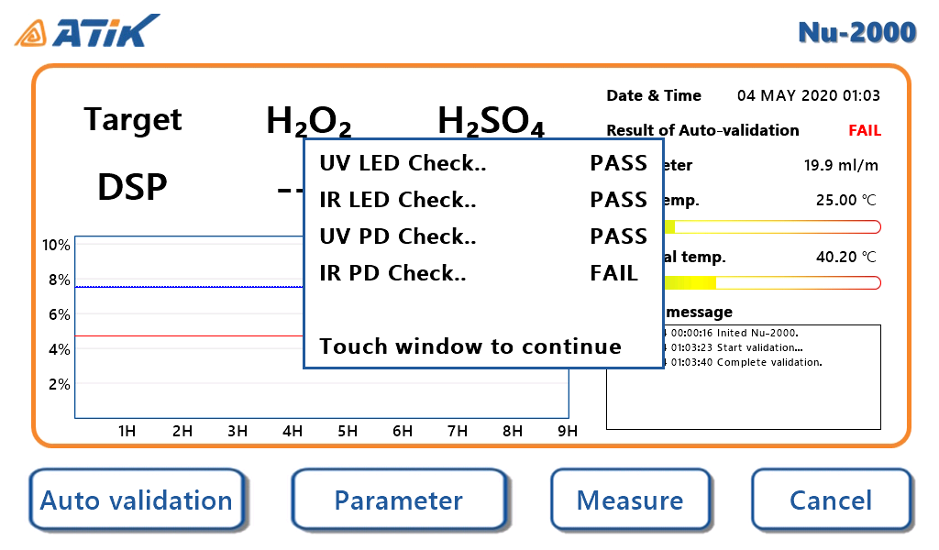
Details - design
Enhanced auto-validation
Nu-2000 Ver1.0
Nu-2000 Ver2.0
More detailed auto-validation process
LED light source validation has been added

Slide 9
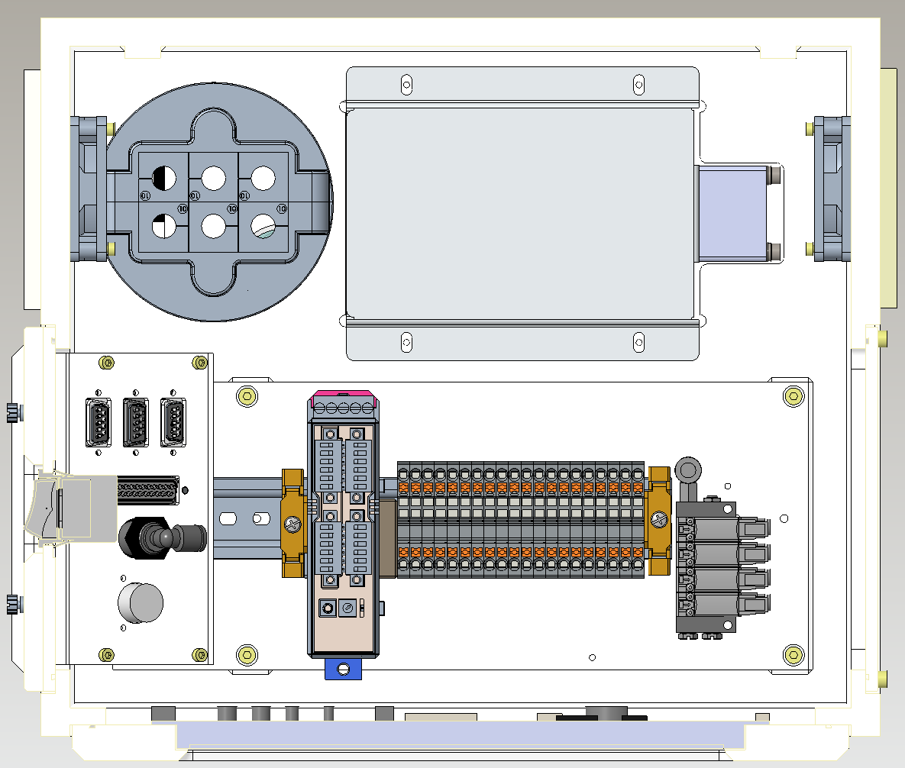
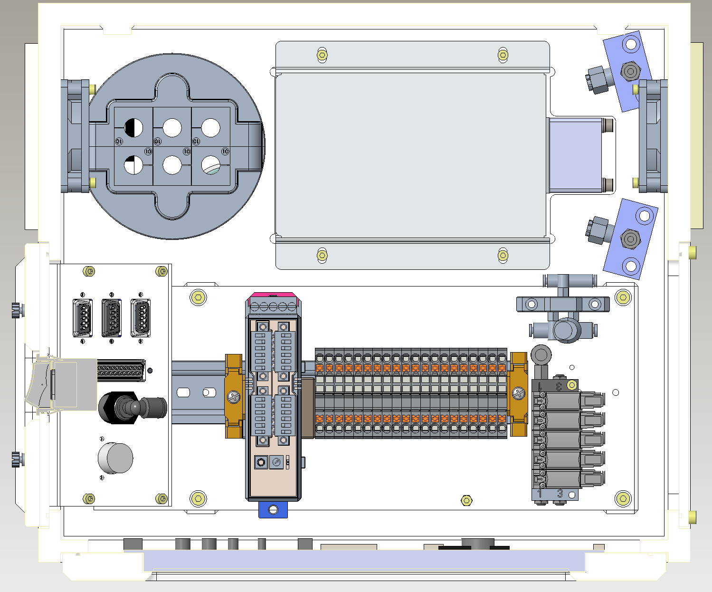
Details - function
Enhanced temperature management
Nu-2000 Ver1.0
Nu-2000 Ver2.0
Two air spray nozzles have been added to rapidly cool down the heat sink
Enhanced temperature management offer greater precision and faster response times.

Slide 10
Thanks
Creativity & Confidence
www.atikorea.com

